Slide 1
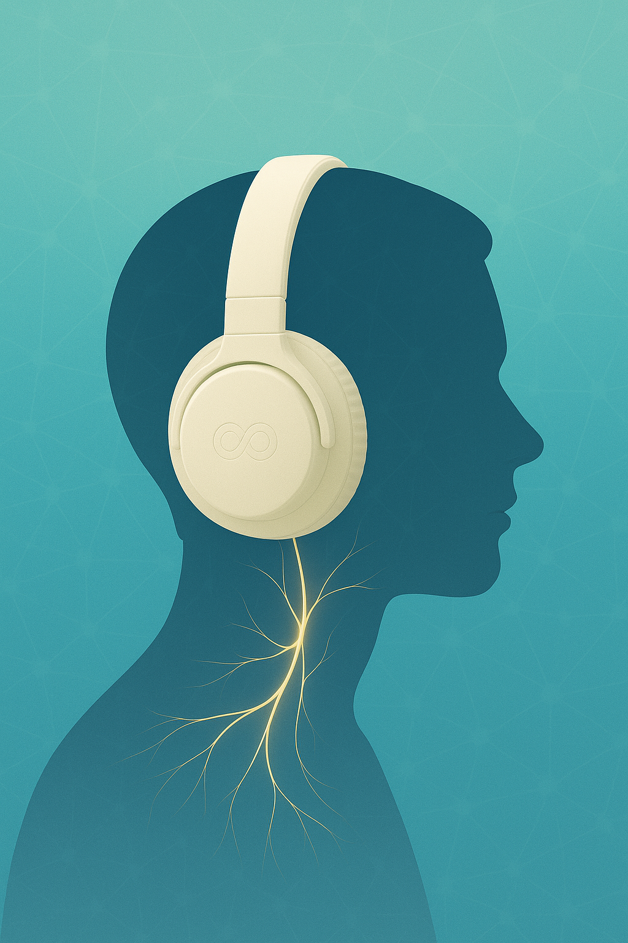
The Vagus Advantage
The Science of Red Light Therapy and Retinal Imaging
Dr. Ray Zhang, MD
and Richard Sprague

Slide 2
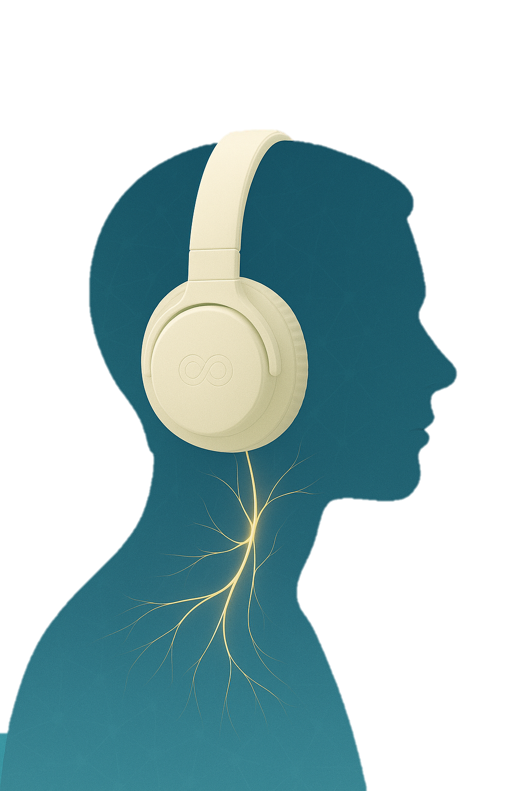
The Vagus Advantage
The New Science to Unlock Your Body’s Cognitive Control System
Dr. Ray Zhang, MD
and Richard Sprague

Slide 3
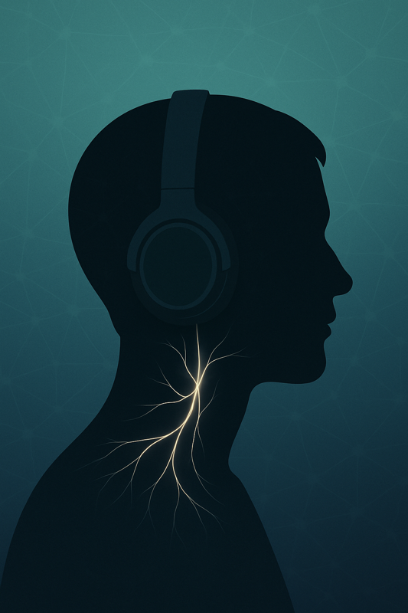
The Vagus Advantage
The Science of Red Light Therapy and Retinal Imaging
Dr. Ray Zhang, MD
and Richard Sprague

Slide 5
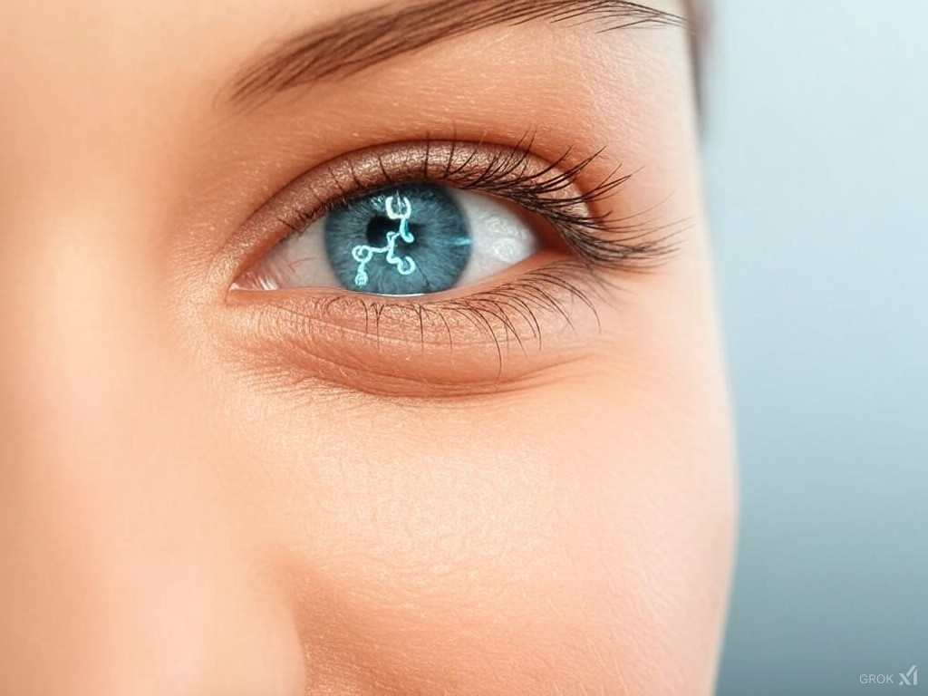
2D Opticare AI
The Red Light Miracle

